Slide 1
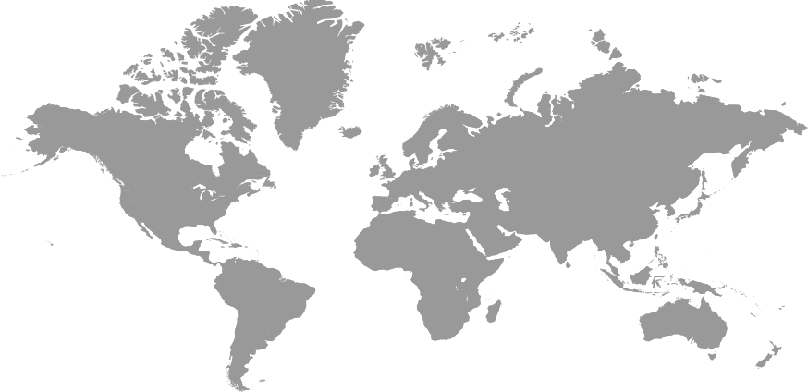
DECENTRALIZED CLOUD STORAGE
SWARA GANDHI & KISHAN KOMALAN

Slide 2







CONTENTS
IDEA
INTERPLANETARY FILE STORAGE
IMPLEMENTATION
NEED OF A NEW INTERNET PROTOCOL??
BLOCKCHAIN
RESULTS
DESIGN
CONCLUSION AND SCOPE
TECHNOLOGY

Slide 3
IDEA
Next generation end to end encrypted, decentralized object storage system using block chain technology where only you have access to your data.

Slide 4
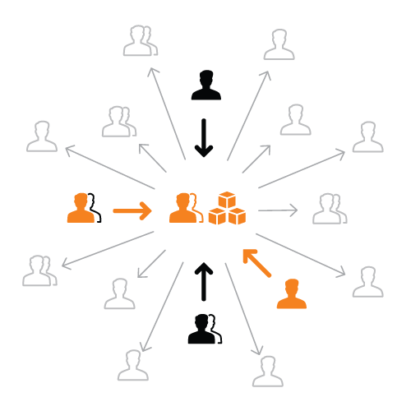
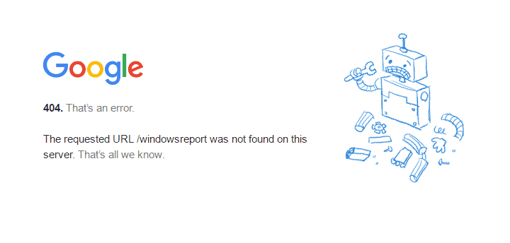
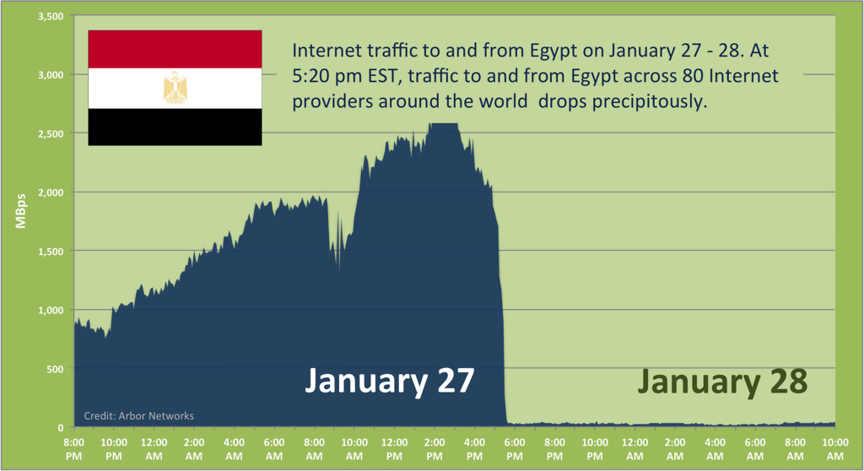
NEED OF A NEW INTERNET PROTOCOL??
IMPERMENANCE
SINGLE POINT OF FAILURE
CENSORSHIP

Slide 5


TECHNOLOGY
INTERPLANETEARY FILE STORAGE
A protocol and network designed to create a content-addressable, peer-to-peer method of storing and sharing hypermedia.
BLOCKCHAIN
A digital ledger in which transactions made in bitcoin or another cryptocurrency are recorded chronologically and publicly.

Slide 6
THE INTERPLANETARY FILE STORAGE (IPFS)
HTTP:
LOCATON ADDRESSING
http://example.com/text
Resolves to location
http://10.20.30.40/text.txt
IPFS:
CONTENT ADDRESSING
http://example.com/text
Resolves to content hash
ipfs/ZJNsqT81qs8Le/text.txt

Slide 7
CONTENT HASHING
HASH VALUE
CONTENT
FILE A
FILE B
FILE C
‘ABC’
123
‘CBA’
321
‘ABC’
123

Slide 8
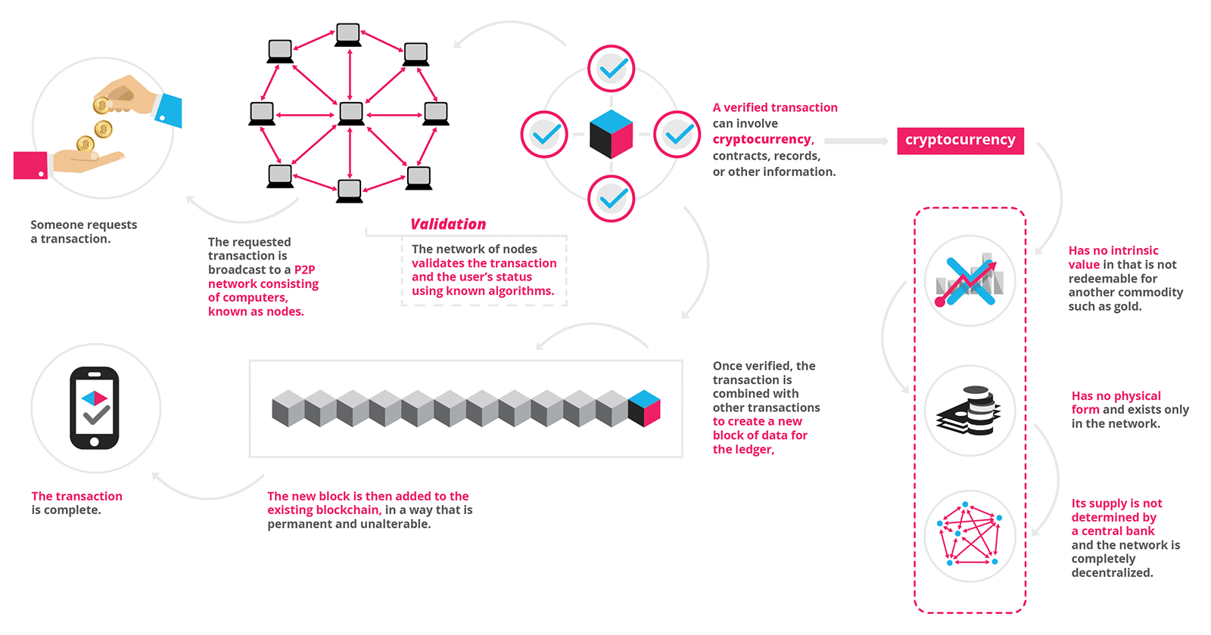
BLOCKCHAIN

Slide 9
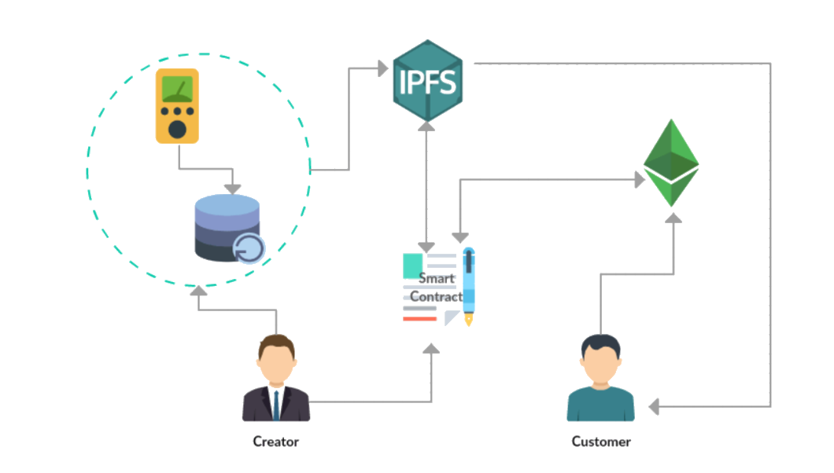
DESIGN
DESIGN

Slide 10
IMPLEMENTATION
Configuring Metamask extension for the browser to interact with blockchain enabled websites
Running the IPFS Infura nodes to connect to system
SMART CONTRACTS
NODE.JS
ETHEREUM
METAMASK
IPFS INFURA
Framework to run all the code in JavaScript using NPM
Contracts implemented on remix ide nodes for legit connection
Ethereum blockchain to store the hash of the saved file on Ipfs

Slide 11
RESULTS
WEBPAGE TO ACCESS THE SYSTEM
NETWORK STATS

Slide 12
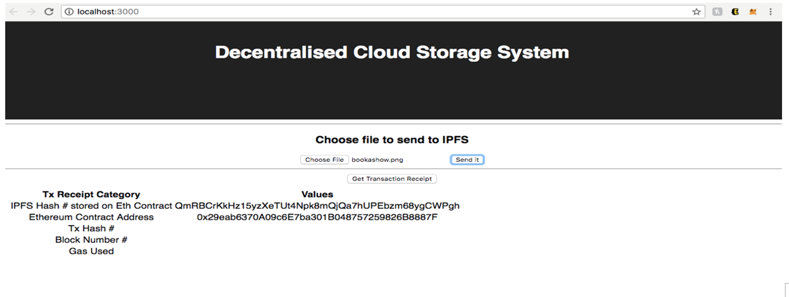

Slide 13
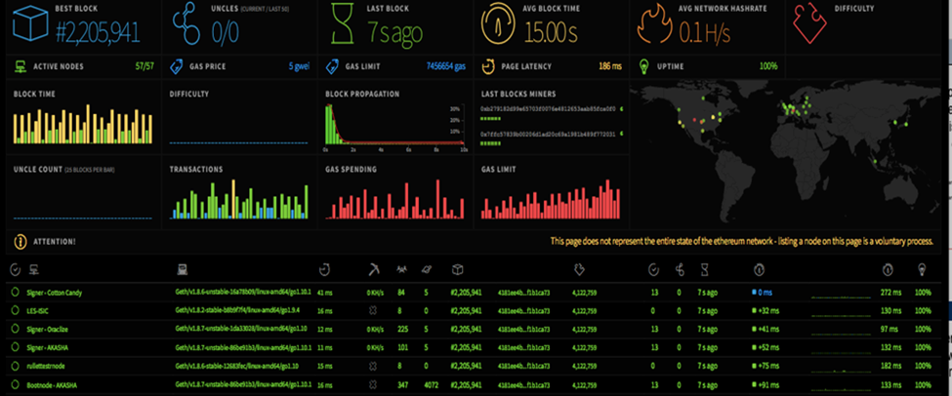
RESULTS

Slide 14
SCOPE
Storage Platform leveraging underutilized hard drive capacity around the world to create a data storage marketplace that is more reliable and lower cost than traditional cloud storage providers.

Slide 15
RESOURCES
Decentralized cloud storage – Storj
https://storj.io/
Blockchain flow
http://blockgeeks.com/guides/what-is-blockchain-technology/
Using rinkeby authenticated faucet for ether
https://www.rinkeby.io/#faucet

Slide 16
THANK YOU

